Slide 1



Plan on Demand

Slide 2


Plan on Demand
Purpose of this report
To be able to see month to date information within the merchandise plan
To show how you are trending for the month with given month to date information.
To see updated and trended OTB figures based on current numbers.
Most often used daily, weekly, throughout the month.
2

Slide 3
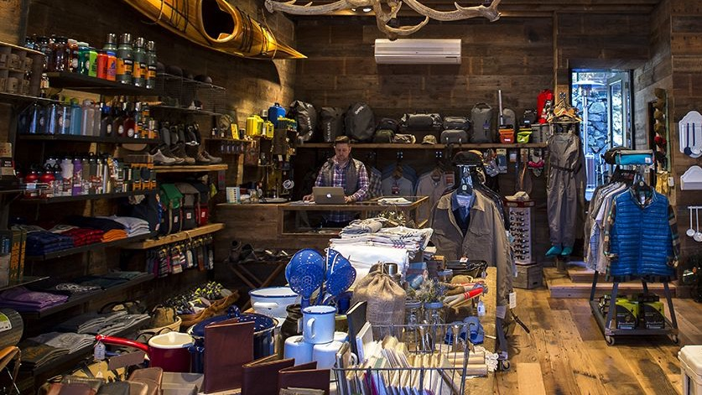

1.
Getting oriented

Slide 4
The header
Shows where the month would end if current sales continued on that trend.
Shows where the month would end if current markdowns continued on that trend.
Shows where the month would end if everything else continued on their trends.
4

Slide 5
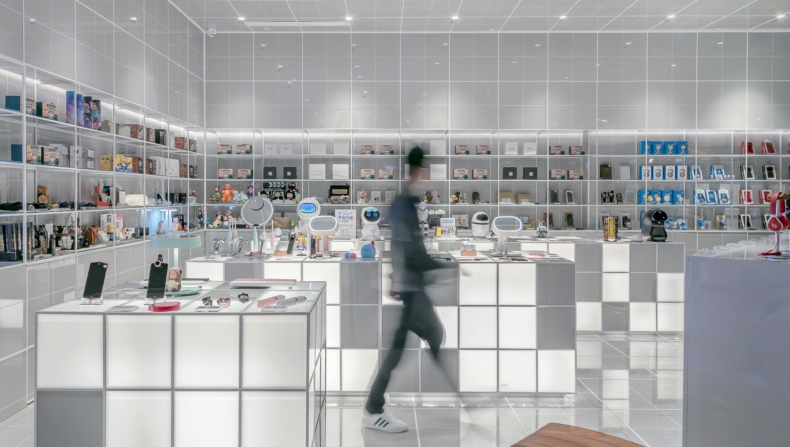
2.
Month to date Updates

Slide 6
Month to Date Updates
Buyer Performance Report
Inventory Action Report
Class Performance Report
Merchandise Plan
OTB Recap
Inventory Performance Report
Plan on Demand
Global Analytical Report
Progress Report
Variance Report

Slide 7
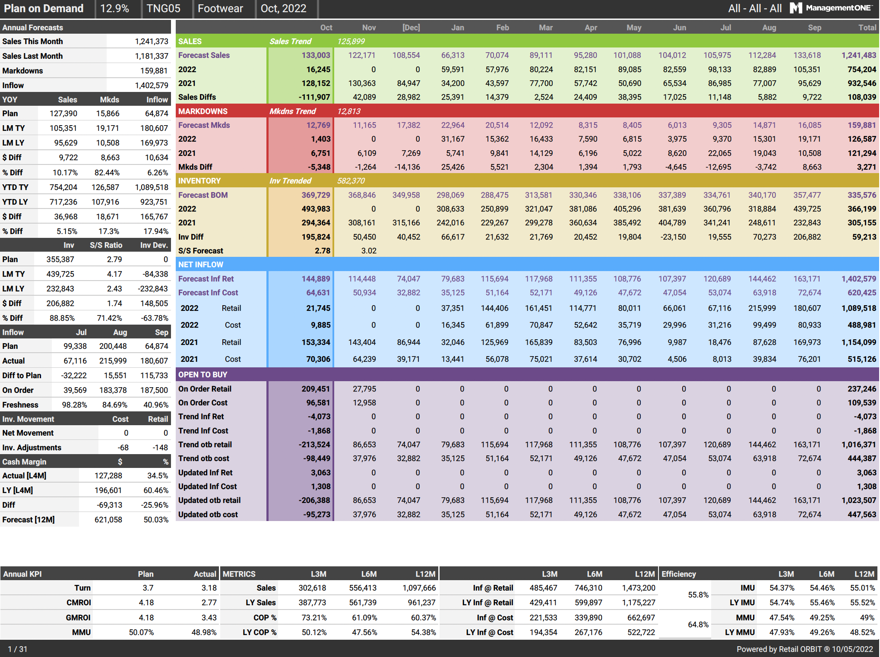
Plan on Demand
The POD is in the same format as the Merchandise Plan

Slide 8
Plan on Demand
The POD is often used as the main reference during Plan review meetings.
It is also useful any day of the month as it shows MTD actuals plus Updated and Trend numbers.

Slide 9
Actual MTD sales
Plan on Demand
Actual MTD MDs
Actual current inventory
Actual MTD inflow
In addition to the Merch Plan data, MTD actual data is included
Actual MTD on order

Slide 10
Trend sales
Plan on Demand
Trend MDs
Trend Inventory
The MTD data is used to provide both Updated and Trend numbers.
Sales Trend assumes the month to date sales rate will be maintained for the entire month. Updated sales recalculates from the MTD status while Plan stays the target.
Trend Inflow
Trend OTB
Updated Inflow
Updated OTB

Slide 11
Trend sales based on MTD sales
Plan on Demand
Trend MDs based on MTD MDs
Trend Inventory based on actual inventory, trend sales & MDs, on order and Inventory Plan for next month
Updated Inflow is new inflow based on MTD status to meet Plan
Trend Inflow to support sales and inventory trends
Trend OTB required to support sales and inventory trends
Updated OTB is new OTB based on MTD status to meet Plan

Slide 12
3.
Using the Report

Slide 13
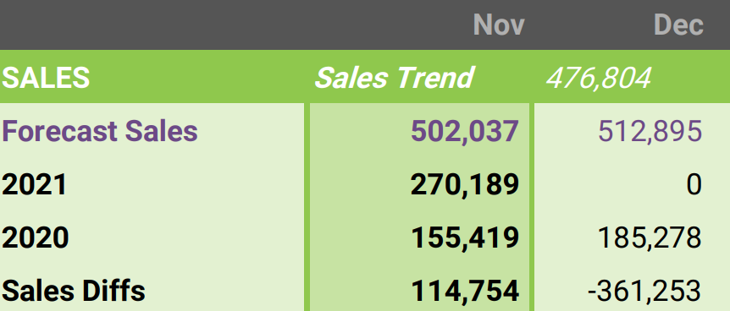
How to use the report
This section allows you to see how the class is trending in sales. Keep in mind that if they had an event, holiday, promotion or will have one later in the month then the trend could be skewed.
Seeing this number and reviewing how in sync or off it is compared to the original sales forecast is a great starting point for discussions.
If sales are trending higher than plan discuss why… is it a new item, different marketing, trunk show, etc.
If sales are trending lower than the forecast, what needs to be done? Do you need to bring in new merchandise, rearrange the store, send out an email blast, or run a promotion?
13

Slide 14
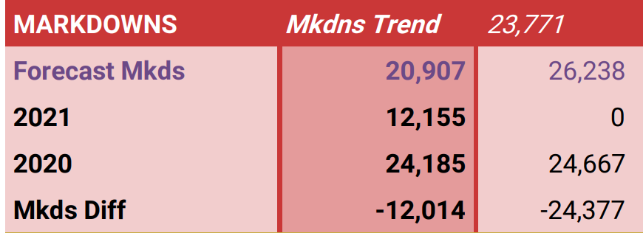
How to use the report
This section allows you to see how the class is trending in markdowns. Keep in mind that if they had an event, holiday, promotion or will have one later in the month then the trend could be skewed.
Looking at the markdown trend allows you to see how much or little of the markdown forecast you are using and where it might end if you continue that way.
This section also helps to keep markdowns in line as well as discuss how it may affect bottom line for the month. If you are trending higher than the forecast, maybe look at the following month to minimize markdowns.
14

Slide 15
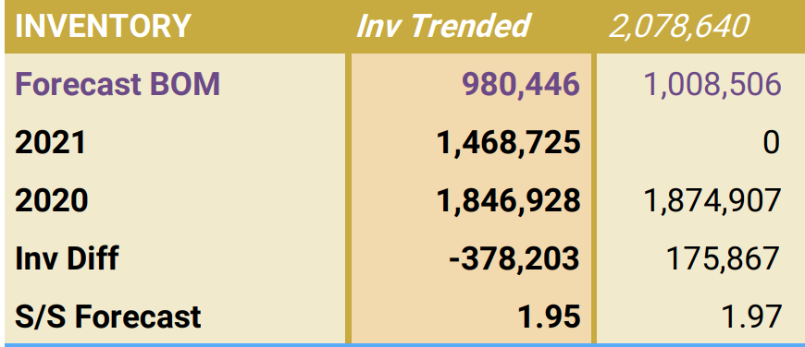
How to use the report
This section allows you to see where the class would end in inventory if everything else continued on trend. Keep in mind that if they had an event, holiday, promotion or will have one later in the month then the trend could be skewed.
Looking at the inventory trend allows you to see where you may start the next month (over or under stocked).
This section helps put what is currently happening into perspective and how it will affect the next month. If sales are trending much higher than plan and inventory is showing lower, using what’s showing in your trended OTB may be more crucial to fill in so you don’t miss sales for the next month.
15

Slide 16
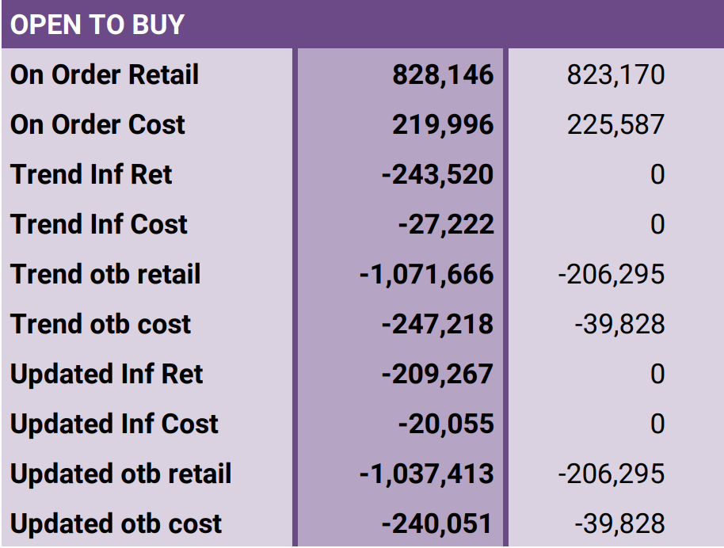
How to use the report
This section shows on order, inflow and OTB. On order is as you would see it on the merchandise plan, except it is updated with current information. The biggest differences in this section are the Trend vs Updated labels.
Trend OTB shows you what is needed (or how much extra stock you have) in order to maintain the sales trend (all with current month to date numbers).
Updated OTB shows what is needed (or how much extra stock you have) in order to maintain forecasted sales (all with current month to date numbers).
16

Slide 17
How to use the report
Using Trend OTB vs Updated OTB
There is no hard and fast rule on when to use trend vs updated OTB. Things to consider though…. Is the month to date information skewed by a holiday, event, weekend, promotion? Is there something out of the ordinary happening? Was there an unexpected snowstorm the first week? If yes to these, you’ll most likely want to use the updated OTB until you see a little more.
Did the client bring in something new that was just a home run for their customers (and they can continue to bring it back in)? Is it halfway through the month and it seems like overall there’s more traffic in the store/online and there isn’t any reason to think it will stop? Has there been new marketing that will continue? For examples like these, you will most likely use the trend OTB.
Keep in mind too that you don’t have to use one version for all. Each classification may have something slightly different going on and would warrant you to switch back and forth between the trend and updated.
17

