Slide 1
Supplemental reports

Slide 2
Week 1

Slide 3
Plans & Reports
Buyer Performance Report
Inventory Action Report
Class Performance Report
Merchandise Plan
OTB Recap
Inventory Performance Report
Plan on Demand
Global Analytical Report
Progress Report
Variance Report

Slide 4
Rules of Thumb
Any report can be used for the monthly meeting.
Not all reports are required to be used for the meeting.
The strength of the supplemental reports is to compare specific data or KPIs by class, by location, etc.
Not all data on a report needs to be reviewed for the report to be used.
The supplemental reports are designed for different purposes.

Slide 5
Monthly usage
Month-to-Date Check
Meeting Prep
Data Check
Take Action
Progress & performance
Global Analytical Report
Variance Report
Progress Report
Inventory Action Report
Merchandise Plan
Establish themes
Catch theft or inventory issues
Class Performance Report
Plan on Demand
OTB Recap
Score Card
Run during the month to check progress
Use any time after 1st of month
Inventory Performance Report
Buyer Performance Report
Recap data from any given time period

Slide 6
Quarterly/annual usage
Month-to-Date Check
Meeting Prep
Data Check
Take Action
Progress & performance
Global Analytical Report
Variance Report
Progress Report
Inventory Action Report
Merchandise Plan
Establish themes
Catch theft or inventory issues
Class Performance Report
Plan on Demand
OTB Recap
Score Card
Inventory Performance Report
Buyer Performance Report
Recap data from a given time period

Slide 7
For monthly and in-month review
Variance Report
Progress Report
Make sure data is correct
Review month-to-date progress to the plan and LY
Global Analytical Report
Inventory Action Report
Review month-to-date progress with projected trend
Incorporates on-order and OTB, updated and trended
Recap and analyze last month sales, 90-day information.
Merchandise Plan OR Plan on Demand
Analyze last month sales, and full classification yearly detail.
POD will give current and trend information.
OTB Recap
Version 1: Basic
Version 2: Detailed, with summary of updated On Order and OTB, trend and cumulative

Slide 8
For quarterly and annual review
Variance Report
Class Performance Report
Review Sales, Inventory, Inflow, Cost of Purchase, IMU, MD, and MMU
Make sure data is correct
Global Analytical Report
Inventory Performance Report
Recap and analyze last 90-day information
Review Cash Margin, Gross Margin, CMROI, GMROI, Turn, Efficiency, Freshness
Merchandise Plan OR Plan on Demand
Analyze last month sales, and full classification yearly detail.
POD will give current and trend information as well.
Buyer Performance Report
Review purchases to plan and adjusted purchases to adjusted plan

Slide 9
Immediate Data Check
Buyer Performance Report
Inventory Action Report
Class Performance Report
Merchandise Plan
OTB Recap
Inventory Performance Report
Plan on Demand
Global Analytical Report
Progress Report
Variance Report

Slide 10
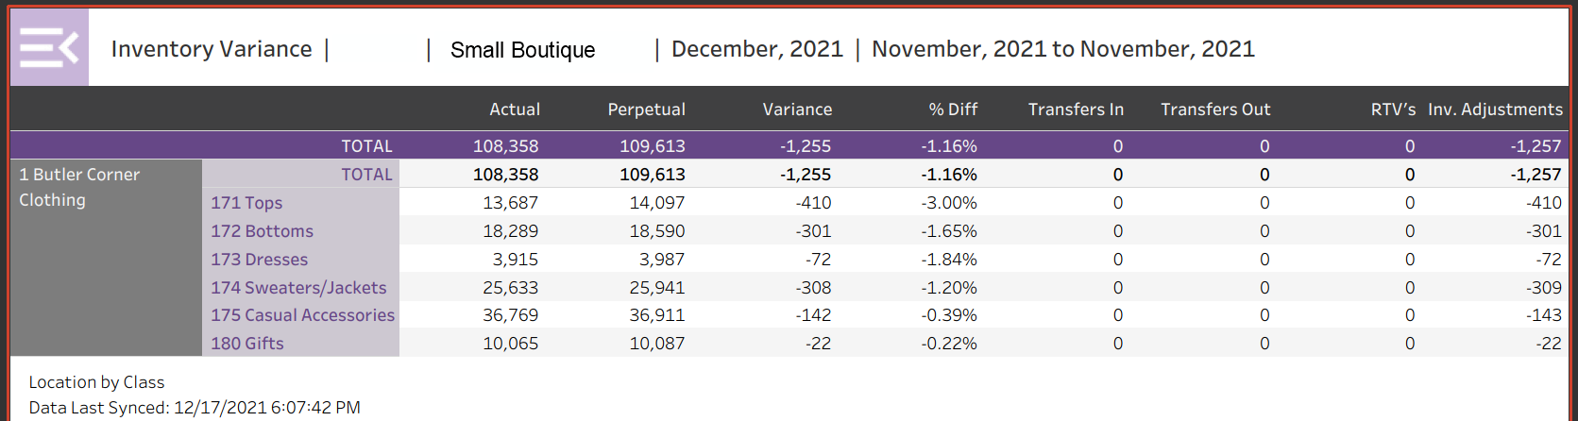
Inventory Variance
Always go to this report first; Highlights big mistakes and errors with inventory
Receiving errors
Physical inventory problems
Internal control problems
  Major thefts
  Problems with shuttle

Slide 11
Inventory Variance
Variance is the difference in dollars between the Actual and Perpetual Inventory
Perpetual is the inventory value calculated using the actual starting inventory, sales, MDs & inflow
Actual is the inventory value uploaded to Retail Orbit

Slide 12
Inventory Variance
Inv. Adjustments are changes made by the retailer in the POS
Transfers In is the value of inventory transferred into this location from other locations
Transfers Out is the value of inventory transferred to another location
RTV’s is the value of inventory returned to vendors

Slide 13
Inventory Variance
Notice, in this example, the Variance matches the Inventory Adjustments

Slide 14
Meeting Prep
Buyer Performance Report
Inventory Action Report
Class Performance Report
Merchandise Plan
OTB Recap
Inventory Performance Report
Plan on Demand
Global Analytical Report
Progress Report
Variance Report

Slide 15
Meeting Prep
Selected period calculations;
Cash margin & CMROI
Gross margin & GMROI
Inventory efficiency
Date analytics for selected period;
Sales, inventory and inflow
IMU, MD’s and MMU
Class Performance Report
Merchandise Plan
Inventory Performance Report
The details by class;
Open to buy
KPI’s, calculations & summaries
History
Forecasts
Summary analytics;
Last month
This month
Last 90 days
On order vs OTB for selectable period
Global Analytical Report

Slide 16
Meeting Prep: Global
Buyer Performance Report
Inventory Action Report
Class Performance Report
Merchandise Plan
OTB Recap
Inventory Performance Report
Plan on Demand
Global Analytical Report
Progress Report
Variance Report

Slide 17
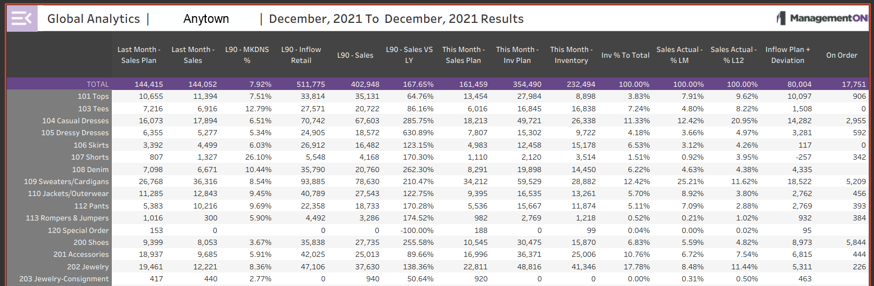
Global Analytics
This is a hybrid report with historical data, current data and forecasts

Slide 18
Global Analytics: Last Month
The Sales Plan and the Actual Sales for the previous month

Slide 19
Global Analytics: Last 90 Days
The next section shows the performance for the previous 90 days including;
  Markdown percent
  Inflow @ retail
  Sales
  Sales percent change vs. last year

Slide 20
Global Analytics: Current Status
The next section shows the current status for;
Sales Plan for this month
Inventory Plan for this month
  BOM Inventory
  Percentage of the BOM Inventory line to the total inventory

Slide 21
Global Analytics: Sales Comparison
The next section shows sales comparisons for;
  Percentage of each lines sales to total sales last month
  Percentage of each lines sales to total sales last 12 months

Slide 22
Global Analytics: BOM Inflow and On Order
The next section uses BOM data to show;
  Inflow required to meet sales plan for the selected period
  Actual BOM on order for the selected period

Slide 23
Global Analytics: Recent Performance
An excellent report to show recent performance including;
  Last month vs Plan
  Last quarter vs last year

Slide 24
Action!!!
Buyer Performance Report
Inventory Action Report
Class Performance Report
Merchandise Plan
OTB Recap
Inventory Performance Report
Plan on Demand
Global Analytical Report
Progress Report
Variance Report

Slide 25
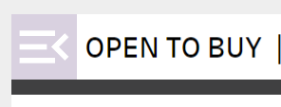
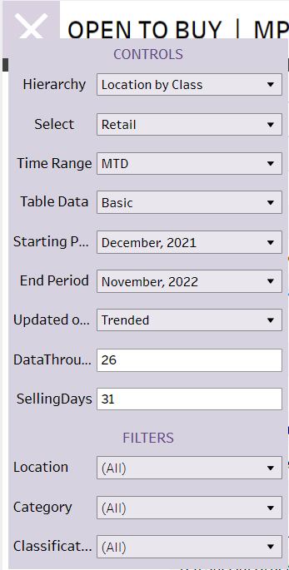
Filters
Mouse click the icon on the upper left of the OTB Recap to open the filter window
Each Plan and Report in ROv2 can be filtered. The OTB Recap Report will be used as an example of available filters.
It is recommended to never use any of the Plans and Reports until first checking the filter setting. For example, we would not want to give a retailer an OTB report with OTB at retail while the client uses OTB at cost.

Slide 26
Filters
Cost or retail
Sort by location, class, etc.
Select the basic or complete version
Select MTD or EOM.
Select the ending month
Select the starting month
Change the MTD days open
Select trend or updated
Sort for all, some or one location
Change the total selling days in month
Sort for all, some or one class
Sort for all, some or one category

Slide 27
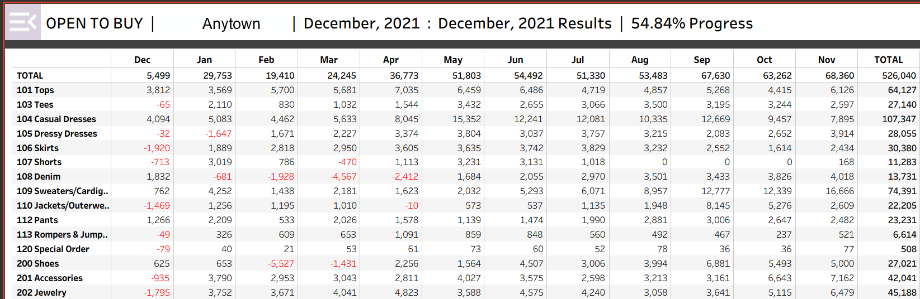
Open to Buy Recap: Basic
The report gives the OTB by class, by month for the selected period of time.
This example is the Basic Sort of the OTB Recap Report, for one location and filtered by class.

Slide 28
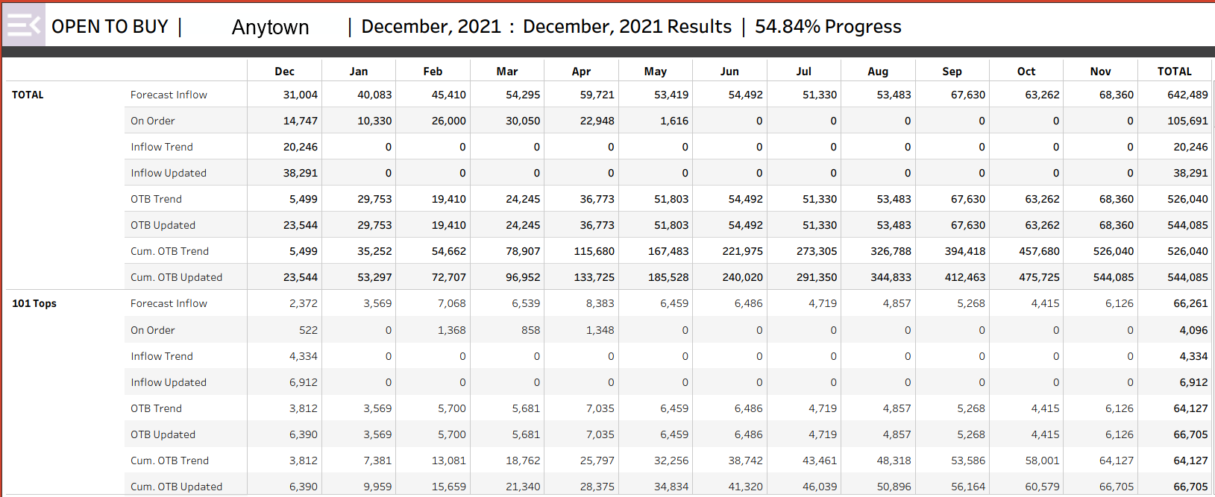
Open to Buy Recap: Complete
The complete version of the OTB recap shows extensive data helpful to a retailer in preparing their future orders.
This example uses the same filters as the basic report on the previous slide, except it is filtered for the Complete Report

Slide 29
Open to Buy Recap: Complete
The report can be filtered for any time period within the next 12 months. For example, a report for next July, August and September

Slide 30
Week 2

Slide 31
Month to Date Updates
Buyer Performance Report
Inventory Action Report
Class Performance Report
Merchandise Plan
OTB Recap
Inventory Performance Report
Plan on Demand
Global Analytical Report
Progress Report
Variance Report

Slide 32
Month to Date Updates
Buyer Performance Report
Inventory Action Report
Class Performance Report
Merchandise Plan
OTB Recap
Inventory Performance Report
Plan on Demand
Global Analytical Report
Progress Report
Variance Report

Slide 33
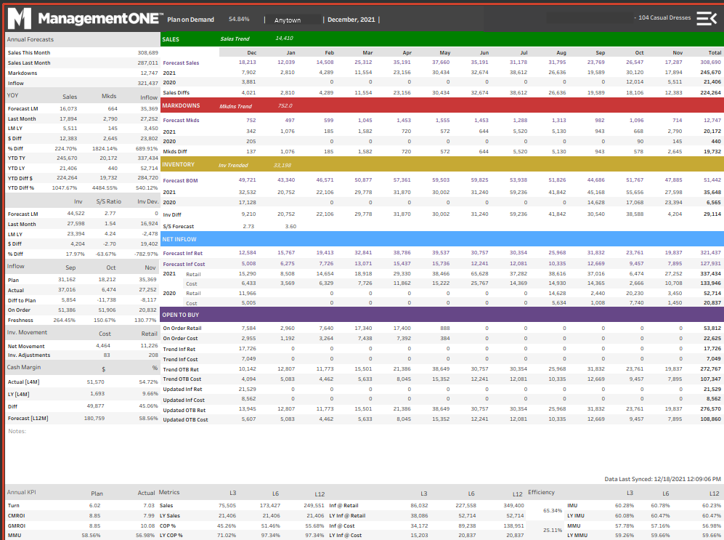
Plan on Demand
The POD is in the same format as the Merchandise Plan

Slide 34
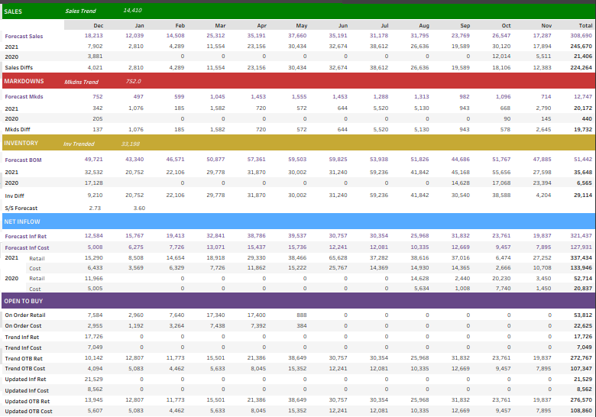
Plan on Demand
Actual MTD sales
Actual MTD MDs
In addition to the Merch Plan data, MTD actual data is included
Actual current inventory
Actual MTD inflow
Actual MTD on order

Slide 35
Plan on Demand
Actual MTD sales
Actual MTD MDs
In addition to the Merch Plan data, MTD actual data is included
Actual current inventory
Actual MTD inflow
Actual MTD on order

Slide 36
Plan on Demand
Trend sales
Trend MDs
The MTD data is used to provide both Updated and Trend numbers.
Sales Trend assumes the month to date sales rate will be maintained for the entire month. Updated sales recalculates from the MTD status while Plan stays the target.
Trend Inventory
Trend Inflow
Trend OTB
Updated Inflow
Updated OTB

Slide 37
Plan on Demand
Trend sales based on MTD sales
Trend MDs based on MTD MDs
Trend Inventory based on actual inventory, trend sales & MDs, on order and Inventory Plan for next month
Trend Inflow required to support sales and inventory trends
Updated Inflow is new inflow based on MTD status to meet Plan
Trend OTB required to support sales and inventory trends
Updated OTB is new OTB based on MTD status to meet Plan

Slide 38
Plan on Demand
The POD has all the of the Merchandise Plan data
The POD is often used as the main reference during Plan review meetings.
It is also useful any day of the month as it shows MTD actuals plus Updated and Trend numbers.
The POD also has the MTD updates
And the Updated and Trend revisions

Slide 39
Month to Date Updates
Buyer Performance Report
Inventory Action Report
Class Performance Report
Merchandise Plan
OTB Recap
Inventory Performance Report
Plan on Demand
Global Analytical Report
Progress Report
Variance Report

Slide 40
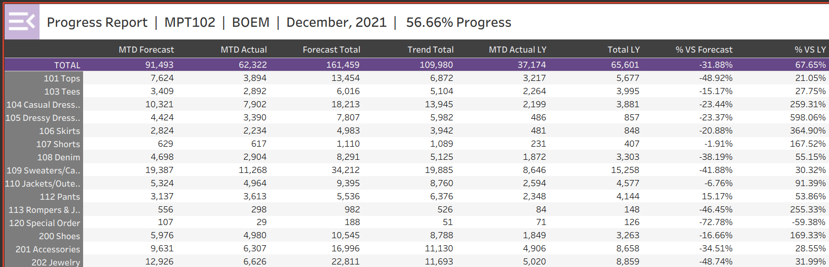
Progress report
The forecast sales for the MTD period
The actual sales for the MTD period
The Progress Report is a streamlined report that makes an excellent quick check every morning for the retailer to see progress against Plan by class

Slide 41
Progress report
The forecast sales for the month
The Trend Sales for the month

Slide 42
Progress report
The LY sales for the same number of days
The total sales for this month last year

Slide 43
Progress report
The MTD sales as a percentage of Plan
The MTD sales as a percentage of sales last year

Slide 44
Action!!!
Buyer Performance Report
Inventory Action Report
Class Performance Report
Merchandise Plan
OTB Recap
Inventory Performance Report
Plan on Demand
Global Analytical Report
Progress Report
Variance Report

Slide 45
Action!!!
Buyer Performance Report
Inventory Action Report
Class Performance Report
Merchandise Plan
OTB Recap
Inventory Performance Report
Plan on Demand
Global Analytical Report
Progress Report
Variance Report

Slide 46
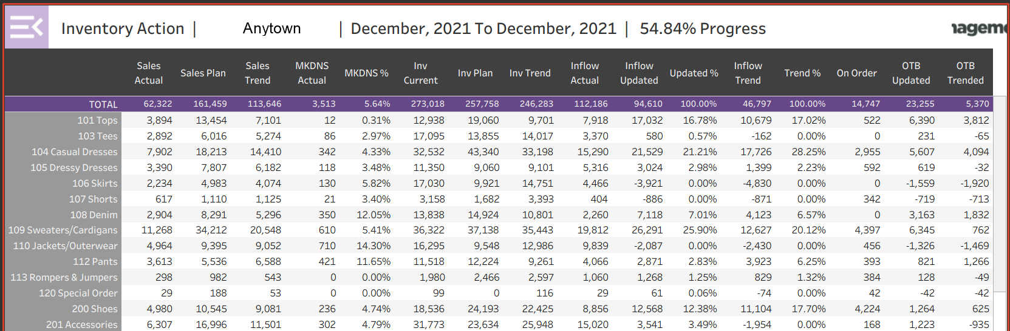
Inventory Action Report
The Inventory Action Report reflects month to date data, forecasts month end status and gives OTB for a selected period based on month to date performance. Very useful to check MTD performance and OTB for a selected period

Slide 47
Inventory Action Report
Sales Trend assumes the month to date sales rate will be maintained for the entire month
There is no column for Updated Sales as this number will always equal the Sales Plan
The Inventory Action Report shows two types of forecasts. Updated is calculated using the plan sales as the end of month forecast. Trend is calculated with each remaining day of the month having sales at the same rate as the month to date sales.

Slide 48
Inventory Action Report
Actual month to date sales
Sales Trend for the entire month based on the month to date sales rate
Sales Plan for the month

Slide 49
Inventory Action Report: Markdowns
Actual MTD Markdowns in dollars
Actual MTD percentage Markdowns

Slide 50
Inventory Action Report: Inventory
Trend Inventory for the end of the month based on MTD inventory and on order for the time period
Actual MTD Inventory
Plan Inventory Plan for next month

Slide 51
Inventory Action Report: Inflow
Actual MTD Inflow
Updated Inflow as a percent of the total Updated Inflow
Inflow to meet Plan for the month

Slide 52
Inventory Action Report: Inflow
Inflow to meet Inventory Trend
Trend Inventory as a percentage of the total Trend

Slide 53
Inventory Action Report: OTB
OTB to meet Trend using MTD as a starting point. Selected for either cost or retail.
On Order for the selected period filtered for either cost or retail
OTB to meet Plan using MTD as a new starting point. Selected for either cost or retail.

Slide 54
Week 3

Slide 55
Meeting Prep
Buyer Performance Report
Inventory Action Report
Class Performance Report
Merchandise Plan
OTB Recap
Inventory Performance Report
Plan on Demand
Global Analytical Report
Progress Report
Variance Report

Slide 56
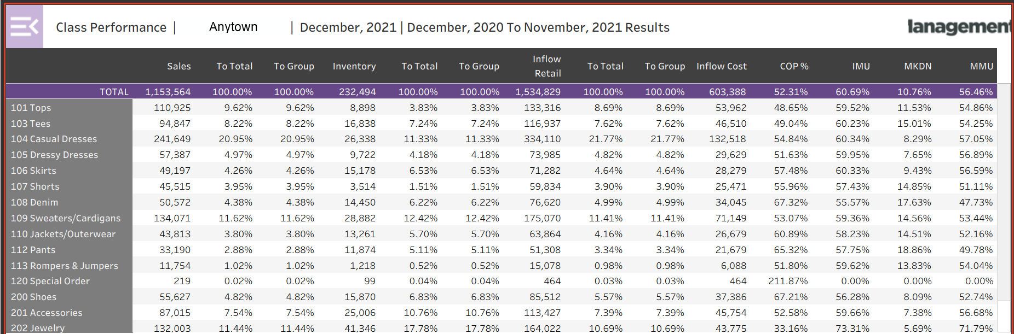
Class Performance Report
The Class Performance Report shows Sales, Inventory, Inflow, COP and MMU related data.

Slide 57
Class Performance Report: Sales
For the time frame selected, the report shows total sales and the percentage of those sales to the total and within the group, if the sort displays a group. This example does not have groups.

Slide 58
Class Performance Report: Inventory
For the time frame selected, the report shows inventory and the percentage of the inventory to the total and within the group, if the sort displays a group. This example does not have groups.

Slide 59
Class Performance Report: Inflow
For the time frame selected, the report shows inflow, at both retail and cost, and the percentage of the inflow to the total and within the group, if the sort displays a group. This example does not have groups.

Slide 60
Class Performance Report: Cost of Purchase
For the time frame selected, the report shows the cost of purchase for each row. The COP is the percentage of sales spent on inflow.

Slide 61
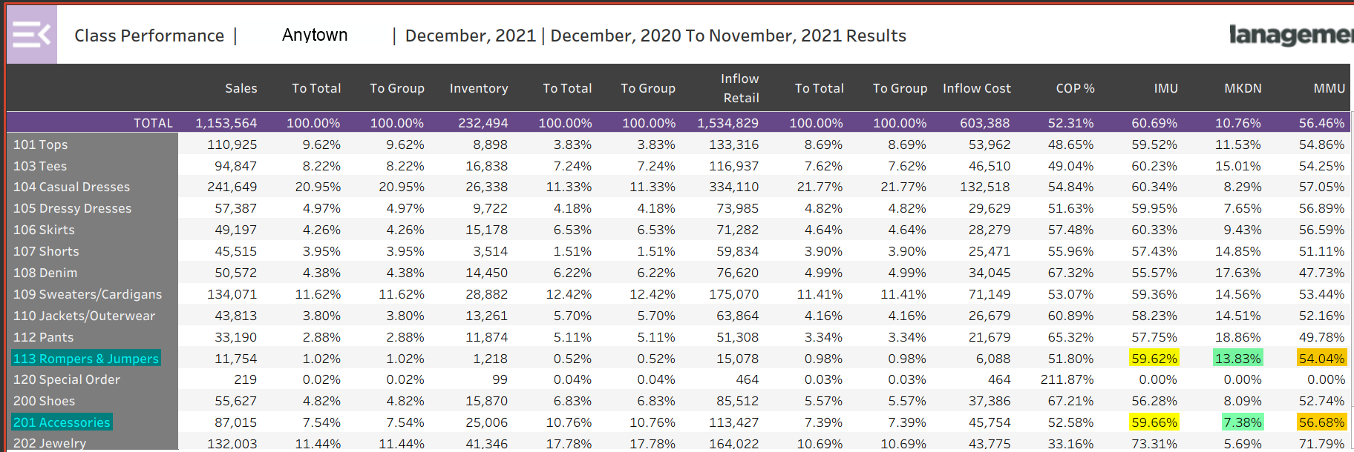
Class Performance Report: MMM by Class
The Markdown percentage is different, Rompers is 13.83 while Accessories is 7.38
Lower Markdowns for Accessories results in an MMU of over 2.5 points higher
Notice the IMU for the two selected classes are almost identical
The Class Performance Report shows Sales, Inventory and Inflow data, but it is an excellent way to see the relationships between IMU, Markdowns and MMU for each class.

Slide 62
Score Card
Buyer Performance Report
Inventory Action Report
Class Performance Report
Merchandise Plan
OTB Recap
Inventory Performance Report
Plan on Demand
Global Analytical Report
Progress Report
Variance Report

Slide 63
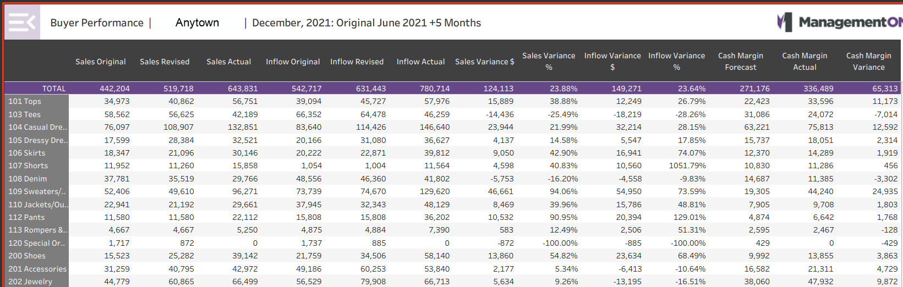
Buyers Performance: Cash Margin by Class
The Buyers Performance Report shows the forecast cash margin for a selected period, the actual cash margin for that period and the variance between them.

Slide 64
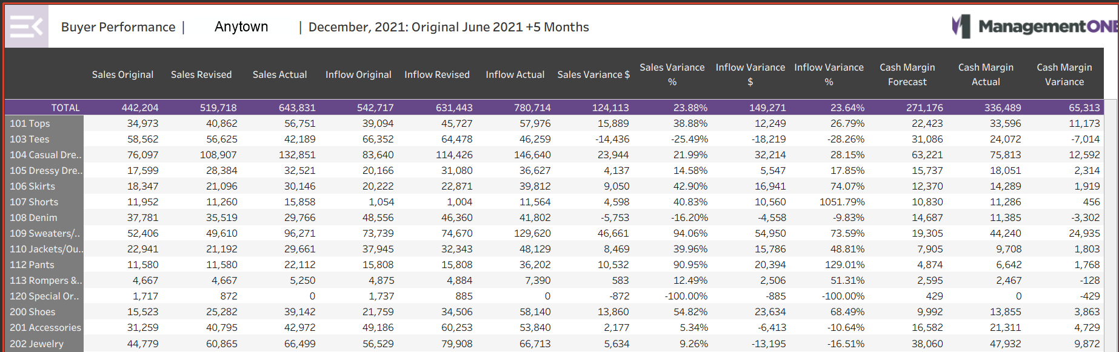
Buyers Performance Report
The Report covers the next five months; July, Aug, Sep, Oct and Nov
The Original Plan numbers are from the June Plan
The Actual sales for the last 5 months
The Sales Plan for the last 5 months from the June Plan
The Sales Plan as revised each month for the last 5 months

Slide 65
Buyers Performance Report:
The Report covers the next five months; July, Aug, Sep, Oct and Nov
The Original Plan numbers are from the June Plan
The Inflow Plan for the last 5 months from the June Plan
The Actual inflow for the last 5 months
The Inflow Plan as revised each month for the last 5 months

Slide 66
Buyers Performance Report:
The Report covers the next five months; July, Aug, Sep, Oct and Nov
The Original Plan numbers are from the June Plan
The percentage difference between the Revised Sales Plan and the Actual Sales
The difference, in dollars, between the Revised Sales Plan and the Actual Sales

Slide 67
Buyers Performance Report:
The Report covers the next five months; July, Aug, Sep, Oct and Nov
The Original Plan numbers are from the June Plan
The percentage difference between the Revised Inflow Plan and the Actual Inflow
The difference, in dollars, between the Revised Inflow Plan and the Actual Inflow

Slide 68
Buyers Performance Report:
The Variance in the Cash Margin between the Revised and Actual Cash Margins
The Original Plan numbers are from the June Plan
The Cash Margin Forecast for the last 5 months from the June Plan
The Report covers the next five months; July, Aug, Sep, Oct and Nov
The Cash Margin Forecast revised each month for the last 5 months

Slide 69
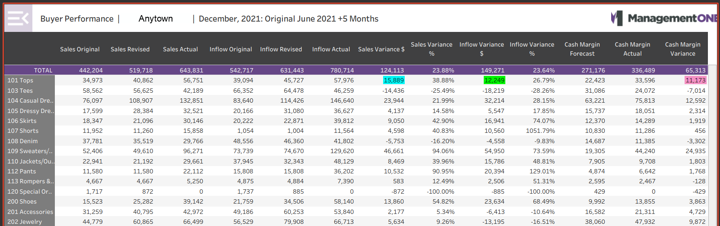
Buyers Performance Report
The Tops class generated 11,173 more in cash margin than planned

Slide 70
Meeting Prep
Buyer Performance Report
Inventory Action Report
Class Performance Report
Merchandise Plan
OTB Recap
Inventory Performance Report
Plan on Demand
Global Analytical Report
Progress Report
Variance Report

Slide 71
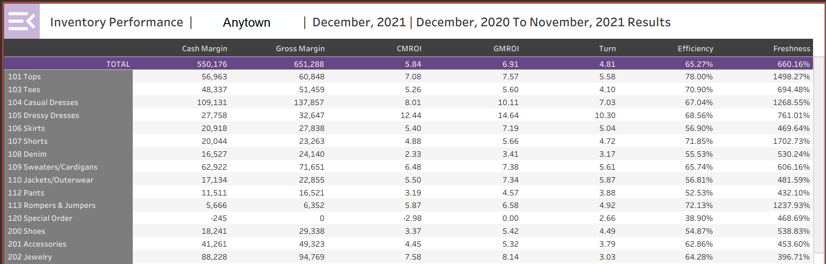
Which Classes are Generating Cash?

Slide 72
Inventory Performance Report: Cash Margin
Cash Margin is the cash dollars generated over a period of time.
Sales – Net Inflow = Cash Margin

Slide 73
Gross Margin
Gross Margin is a calculation of dollars generated over a period of time. Can be calculated two ways;
Sales – COGS = Gross Margin
or
Sales * MMU

Slide 74
Gross Margin
Gross Margin dollars is related to MMU. So gross margin reflects sales, IMU and MDs.

Slide 75
Cash In Hand
Cash Margin indicates the cash we put in the bank while Gross Margin does not.

Slide 76
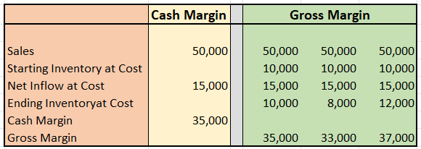
Cash Margin vs Gross Margin
Cash Margin and Gross Margin are equal if the starting and ending inventory values are the same.
If the values are different, the Gross Margin will be different.
Remember, this class put 35,000 in the bank before expenses, but we cannot determine that from Gross Margin

Slide 77
Inventory Performance Report: CMROI
CMROI is the Cash Margin dollars returned for every dollar invested, normally over a one year period. A rule of thumb; we need a CMROI of at least 2.00 to make money. The first dollar buys new goods and the second helps pay for expenses.
Formula: CMROI = Cash Margin Dollars
Average Inv. @ Cost

Slide 78
Inventory Performance Report: GMROI
GMROI is the Gross Margin dollars returned for every dollar invested, normally over a one year period. A rule of thumb; we need a GMROI of at least 2.00 to make money. The first dollar buys new goods and the second helps pay for expenses.
Formula: GMROI = Gross Margin Dollars
Average Inv. @ Cost

Slide 79
Inventory Performance Report: Turn
Turn is the number of times the average inventory is sold through, normally over a one-year period.
Formula: Turn = Sales for the period
Average Inv. @ Retail

Slide 80
Inventory Performance Report: Efficiency
Efficiency: How effectively on hand stock has been turned into cash, normally over the last 12 months. Similar to sell through.
  Formula:
  Sales for the period
  BOM Inv. @ retail + net inflow @ retail

Slide 81
Inventory Performance Report: Freshness
The percentage of inventory newer than the time frame selected. This report is for a year, so the freshness is not informative. To be meaningful, we would need to filter for one month or for just several months. If the percentage is greater than 100% , it indicates the inventory was sold through more than once

Slide 82
Inventory Performance Report: Compare
Compare which classes are generating cash margin and other metrics. See the top performers and those not performing so well

