Slide 1



Buyer Performance Report
Holding the buyer accountable

Slide 2


Buyer Performance
Purpose of this report
Compare inflow with the plans, and stack this information against cash margin figures.
Can be used monthly, but mostly used quarterly, seasonally, or annually depending on seasonality of merchandise.
2

Slide 3
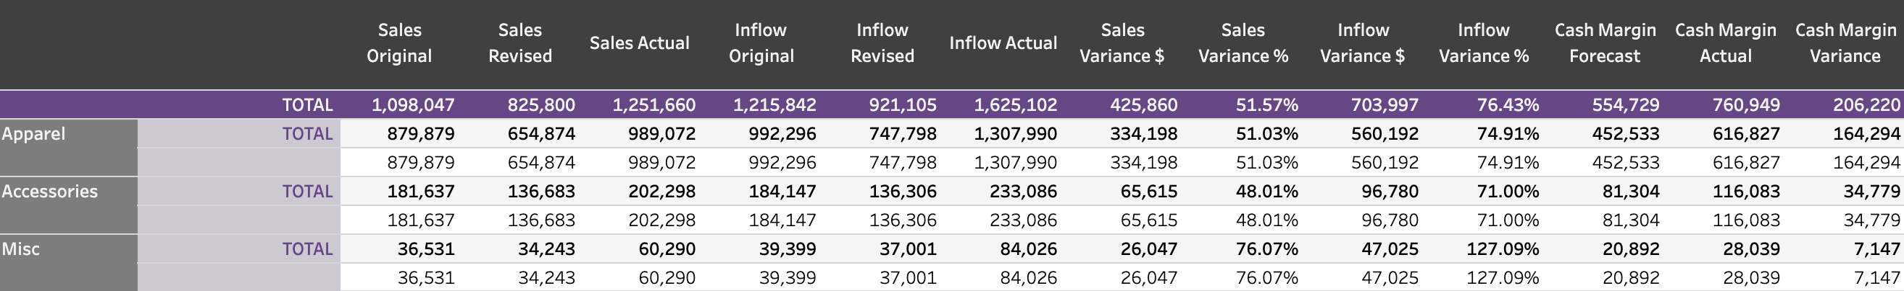
Buyer Performance Report
(shown by category)
3

Slide 4
The header
Sales and Inflow actuals vs. revised plan
Sales and Inflow:
What was the original plan, revised plan, and actual sales and inflow numbers for that time frame?
Cash Margin actuals vs. forecast
4

Slide 5
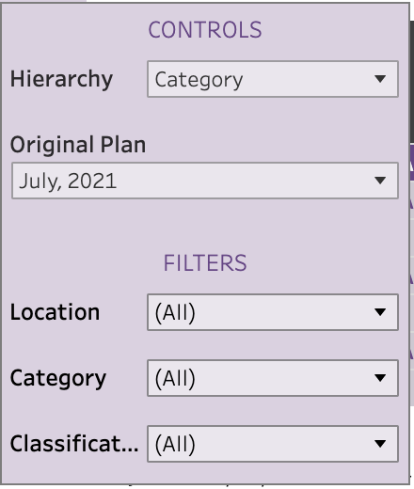
Organizing the data
Similar to many of the other reports, you have the capability to choose how you want to see the data.
You can control the way it’s organized (hierarchy) as well as the timeframe for the data.
You can look at specific locations, categories or classifications to isolate trends for individual buyers.
5

Slide 6
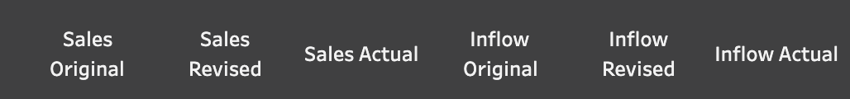
How to use the report
The first section allows you to see if the buyer followed plan for inflow and how that may have affected sales.
Did the buyer overbuy and still not make as much in sales vs the plan?
Did the buyer under purchase and not make as much compared to plan?
Did the buyer over purchase and make more in sales (check margins to make sure they still profited)
6

Slide 7
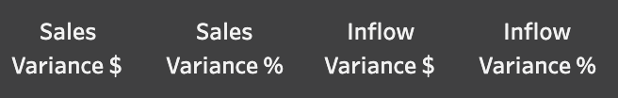
How to use the report
The next set of headers allows you to see the Sales and Inflow variances side by side.
Was a correlation between the two?
What was the dollar difference?
How can focusing on the dollars help drive home key points you need to make to the client?
7

Slide 8

How to use the report
See how the cash margin differed, and whether other components impacted the actuals.
Similar to the middle section you are able to clearly see the differences between sales and purchases.
More sales doesn’t always mean they are doing better. Did the buyer have to purchase a lot more to get those sales, but is still left with a lot of inventory and lower cash margin?
8

Slide 9
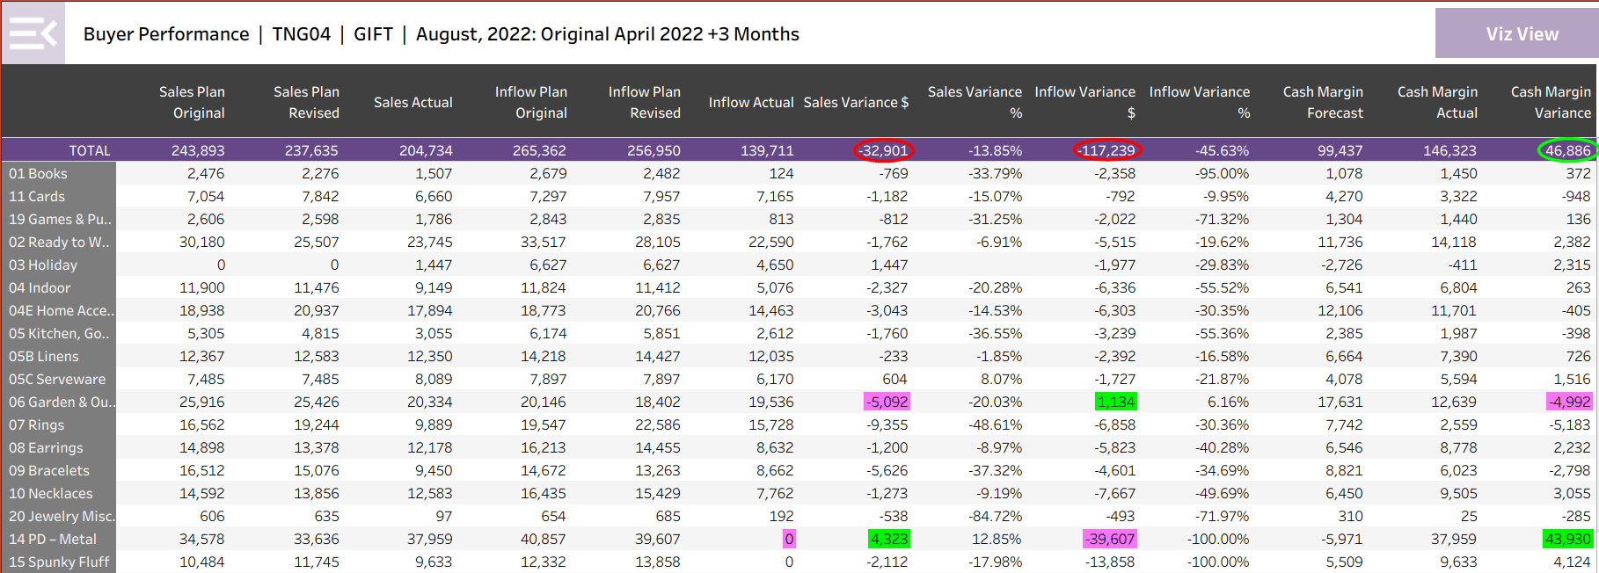
Buyer Performance
There are two ways to use the Buyer Performance Report:
To show how each class generated cash margin relative to the plan potential.
How the buyer performed relative to Plan.

Slide 10
Buyer Performance
Notice class 06 had a negative sales variance of 5K, a positive inflow variance of 1K resulting in a negative cash margin variance of 5K.
Class 14 had a positive sales variance of 4K, a negative inflow variance of 39K resulting in a positive cash margin variance of 44K. Notice this was caused by zero inflow during the period.

Slide 11
Buyer Performance
The Buyer Performance report can clearly illustrate;
The classes that are performing up to Plan in generating cash margin.
If it is sales or inflow causing the variances.
To owners, managers and buyers the impact of not buying the Plan.

