Slide 1



Class Performance Report

Slide 2
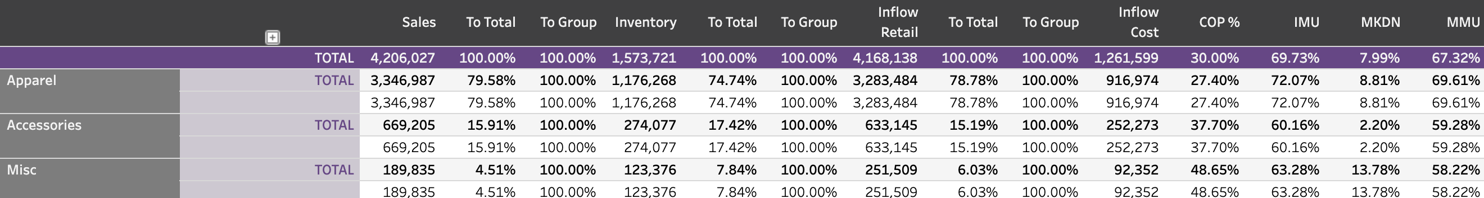

The Class Performance Report
(shown by category)
2

Slide 3

Class Performance
Purpose of this report
See a classification’s performance across a period of time using a variety of metrics.
Most often used quarterly or annually.
3

Slide 4
The header
Looks at actual sales to planned sales as well as 90-day trends
Looks at Inflow at retail as percentage to total and group. Then looks at Inflow at Cost with Cost of Purchase percentage
Looks at the initial markup, markdown and ultimately maintained markup
4

Slide 5
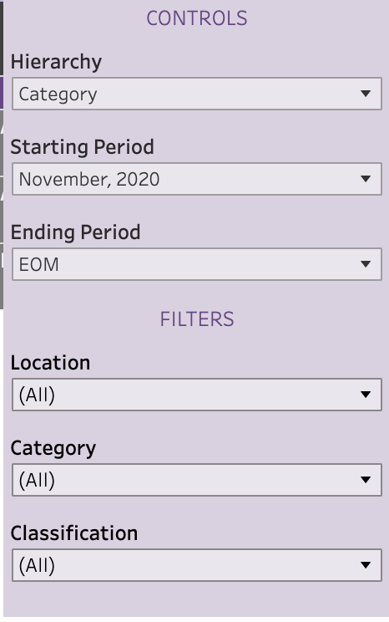
Organizing the data
Similar to many of the other reports, you have the capability to choose how you want to see the data.
You can control the way it’s organized (hierarchy) as well as the timeframe for the data.
You can look at specific locations, categories or classifications to isolate trends for individual buyers.
5

Slide 6
How to use the report
See actual sales and inventory for a class/ category/location and drill down from whichever top-level you choose.
Do the sales and inventory percentages match and make sense?
Sometimes you may find classes are taking up too much or too little inventory from the group and it’s affecting sales.
6

Slide 7

How to use the report
See inflow in the same view, note the cost, and compare to sales with COP%
How well did your purchases work for you?
The cost of purchase percentage will help identify any red flags here as it shows the relationship between the amount purchased at cost and sales for the same period.
When purchases at cost get too close to the sales number (a higher percentages) it shows you may have overbought.
7

Slide 8

How to use the report
v
Looking at the initial markups, markdowns and maintained markups is a great way to recap a season or quarter.
Guide follow-up questions: What is causing IMUs to be down and markdowns to be up in a given assortment?
This report helps drive deeper reviews of pricing strategies, vendor report cards, and best/worst seller reports.
Adding in child classes helps narrow down which merchandise is failing to perform.
8

Slide 9
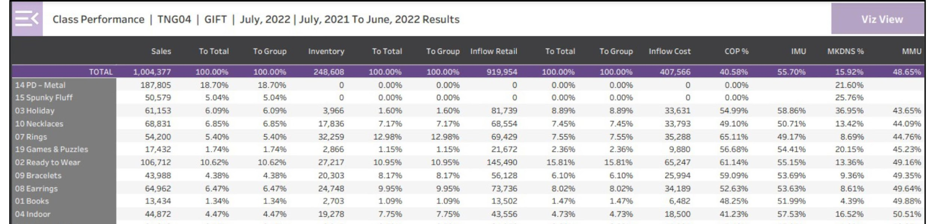
Plan Review Meeting: Class Performance
The class performance report is used to analyze other metrics and KPI’s. Like the inventory performance report, each of the columns can be sorted in ascending or descending order.
One of the very useful aspects of this report is the ability to:
  See the IMU, MDs, and MMU for each class side by side.
  Compare the above item’s class to class or to the store average.

Slide 10
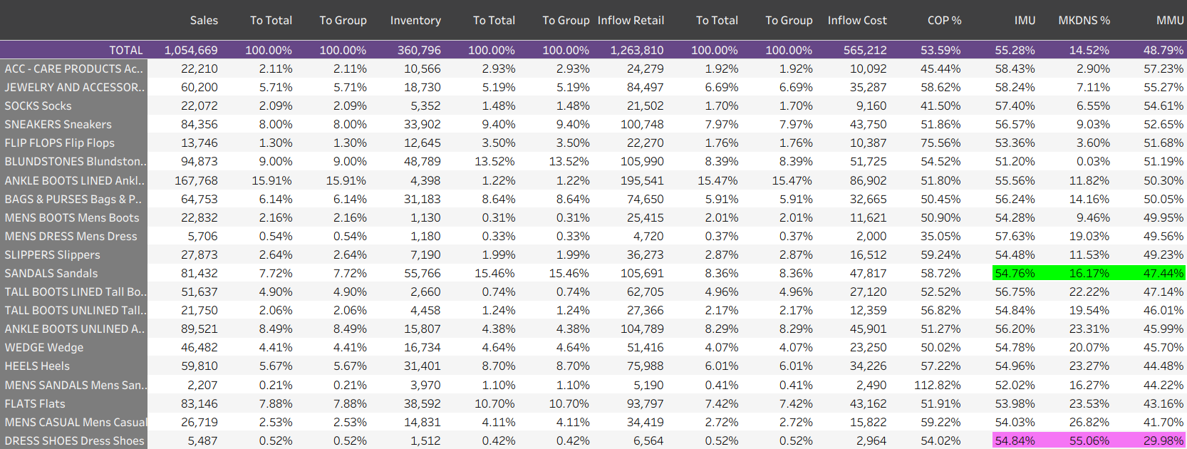
Class Performance: Margins
The class performance report shows the IMU, MDs and MMU for each class in the store. This one is sorted for high to low MMU. Notice the two highlighted classes have similar IMUs but very different MDs and MMUs.

Slide 11
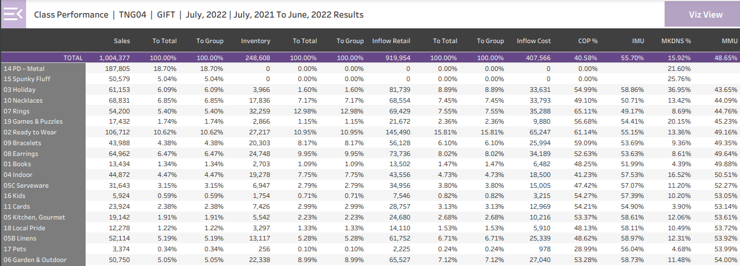
Class Performance: Margins
Like the inventory performance report, each column of the class performance report can be sorted from high to low or low to high. This example is sorted from low to high MMU.

Slide 12
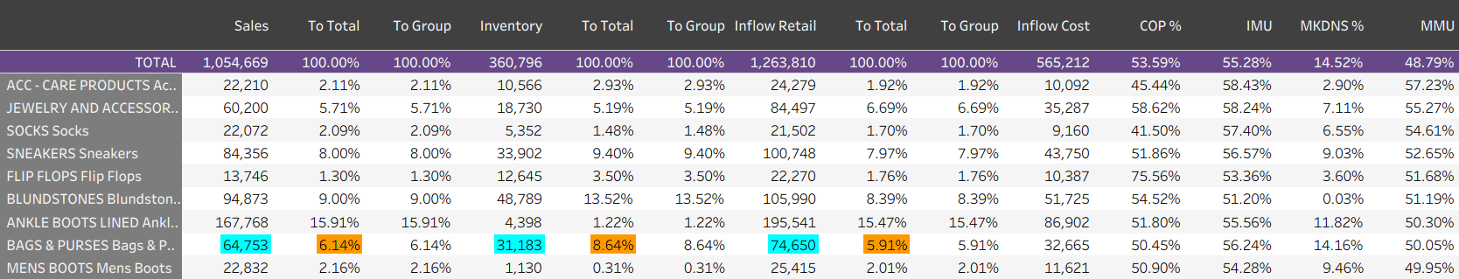
Class Performance: Margins
The class performance report can also be used to show the relationship between sales, inventory and inflow for each class and also for class-to-class comparisons.
This example highlights the sales, inventory and inflow for Bags & Purses in blue and the percentages in brown. We can see that Bags had 6.14% of the sales while they have 8.64% of the inventory. Over the last year, sales were 64,753 while inflow at retail was 74,650.

Slide 13
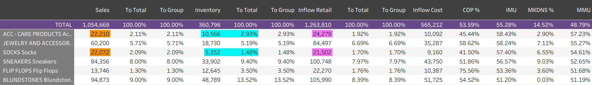
Class Performance: Margins
Notice the Sales for the two highlighted classes are essentially the same and the Inflow is similar. However, the Inventory is different by a factor of 2X.
This may indicate the need for additional analysis on the Merch Plan or other auxiliary reports.

Slide 14
Class Performance: Margins
This report can identify potential opportunities by:
  Highlighting classes where inventory and/or inflow are out of proportion
  Illuminating issues with Cost of Purchase
  Showing us classes that are weak in the margin columns of IMU, MDs and MMU.

