Slide 1



Inventory Performance Report

Slide 2


Inventory Performance
Purpose of this report
See how inventory works with relation to key performance indicator metrics.
Most often used quarterly or annually.
2

Slide 3
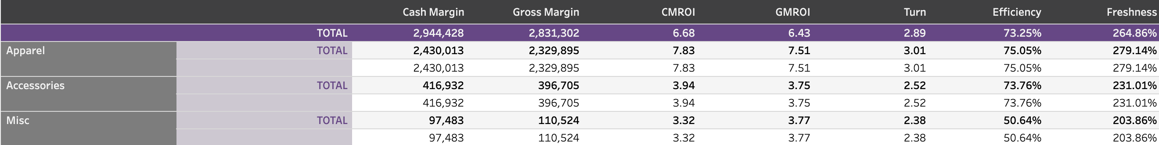
The Inventory Performance Report
(shown by category)
3

Slide 4
The header
Looks at a class/category/location’s margin dollars as well as return on investment, which takes into consideration the time aspect.
Looks at how quickly/slowly you are turning your product, what the sell through is, and how new or fresh your merchandise potentially is.
4

Slide 5
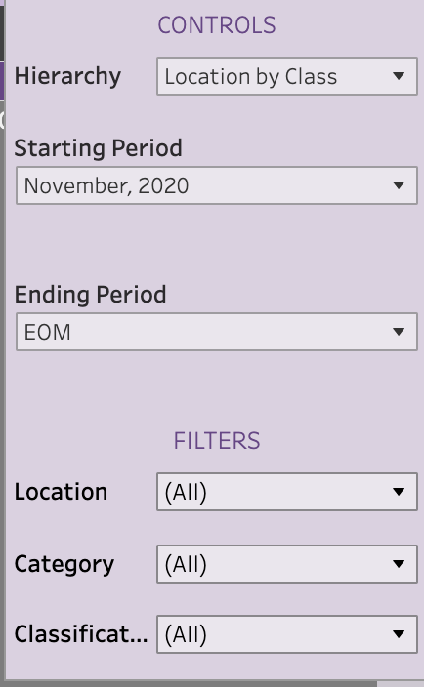
Organizing the data
Similar to many of the other reports, you have the capability to choose how you want to see the data.
You can control the way it’s organized (hierarchy) as well as the timeframe for the data.
You can look at specific locations, categories or classifications to isolate trends for individual buyers.
5

Slide 6
How to use the report
Being able to see both cash margin (unique to M1) and gross margin with returns will help identify any underperforming categories/locations/classes.
A 2 or above is usually the goal
You want the client to get back the money they are putting in and have enough to pay for the purchase.
6

Slide 7
How to use the report
Additional KPIs added to this view creates a true picture of inventory performance.
Assessing turn
For turn rates remember there isn’t a one size fits all number here. Different classes may turn over their product more slowly or quickly.
Products with many sizes (shoes, pants) usually have lower turn due to increased inventory. Fewer sizes (tops, for instance) will have less inventory per style.
Also think of seasonality in relation to turn. The more seasonable products the faster the turn should be. Swim, for instance, should move fast in a short window of time.
7
The next set of headers allow you to see inflow in a similar way to sales and inventory, but with this section you are also given the inflow at cost and cost of purchase percentage to see if there are any correlations between the numbers.
Having all the key performance indicators in one area really helps you to see the true picture of how the inventory is performing and in return also helps guide actionable plans to underperforming classes. For turn rates remember there isn’t a one size fits all number here. Different classes may turn over their product more slowly or quickly.
Turn- Ask yourself, does the product have a lot of sizes (shoes and pants). If so, this usually has lower turn due to needing that much more in inventory to cover all the sizes. As opposed to let’s say a tops section that has only 3-5 sizes. Also think of seasonality in relation to turn. The more seasonable products the faster the turn should be so you are in and out of the product quicker (ie swim)

Slide 8
How to use the report
Assessing efficiency/sell-through
If the percentage is low that may indicate the items were unfavorable
Paired with the other metrics, however, you can also identify cases in which the items were great sellers, but were simply over-bought.
Assessing freshness
Freshness indicates newness, and newness sells!
Use this area to illustrate how holding onto a low-performing vendor, overbuying, or refusing to take markdowns can impact the overall business.
8

Slide 9
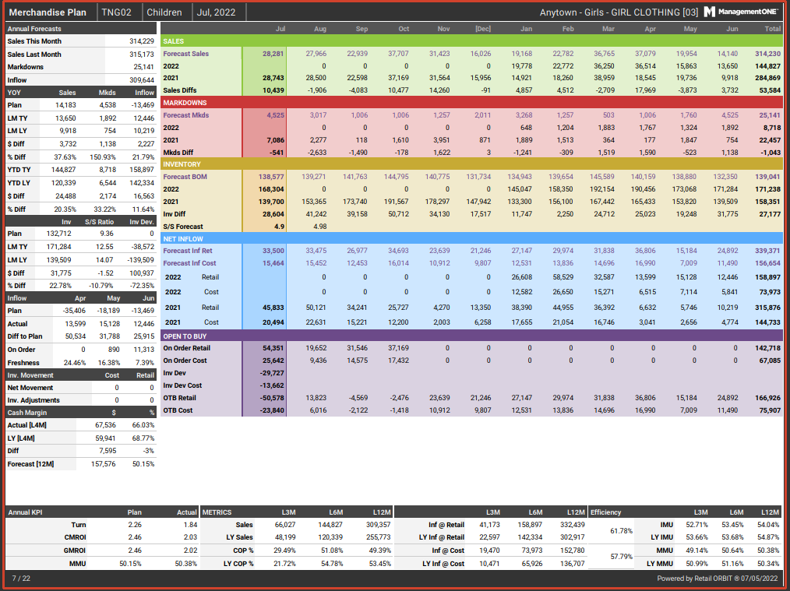
Plan Review Meeting
As you review the individual Plans, you may notice areas of concern or themes that auxiliary reports can help analyze.
For example, Turn seems low here. We will check the Inventory Performance Report.

Slide 10
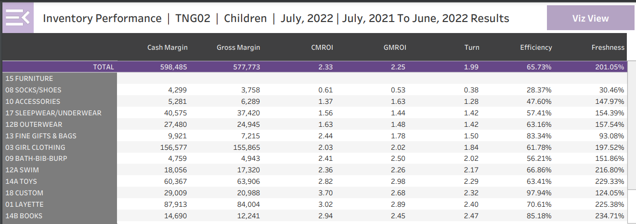
Plan Review Meeting:
Inventory Performance
This version of the inventory Performance Report shows the turn for each class in the store and is sorted for low to high turn. We can see the turn overall is low and is even below 2.00 for half the classes.

Slide 11
Plan Review Meeting:
Inventory Performance
This version of the inventory Performance Report shows the turn for each class in the store and is sorted for low to high turn. We can see the turn overall is low, and is even below 2.00 for half the classes.

Slide 12
Plan Review Meeting:
Inventory Performance
The Inventory Performance Report can also rank low to high or high to low for other KPIs and Metrics including:
  Cash Margin
  Gross Margin
  CMROI
  GMROI
  Efficiency
  Freshness

Slide 13
Plan Review Meeting:
Inventory Performance
Opportunities may be identified by seeing:
Classes that are negative or positive outliers
An overall weakness in a KPI, such as CMROI
Classes with dated inventory or poor efficiency.

Slide 14
Plan Review Meeting:
Inventory Performance
When to use:
To illustrate items of interest or concern during monthly meetings
For quarterly or other periodic reviews

