Slide 1



Inventory Variance Report
Tracking Inventory Movement

Slide 2
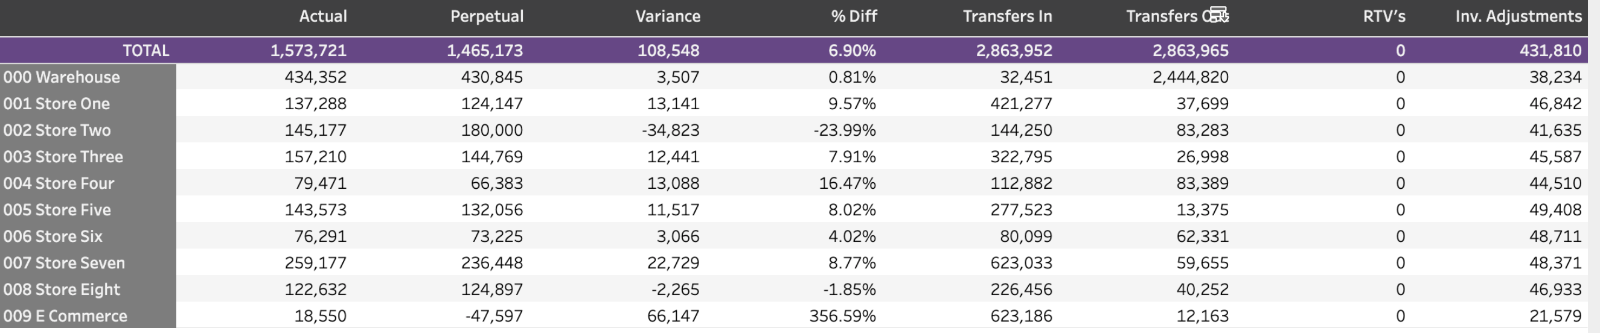

Inventory Variance Report-
(shown by location)
2

Slide 3

Inventory Variance
Purpose of this report
To discover any issues with inventory data
To understand how transfers are affecting net inflow across locations
To review how the variance is accounted by in inventory adjustments
Used monthly in conjunction with set time frames
3

Slide 4
The header
Actual inventory value from POS
Adjustments within inventory
Difference of Actual vs Perpetual as a dollar amount and %
Inventory transfers in and out at retail
Continuously calculated inventory
Returned inventory back to vendors
4

Slide 5
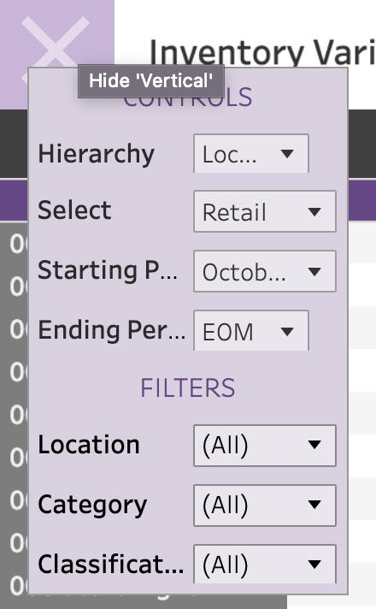
Organizing the data
Similar to many of the other reports, you have the capability to choose how you want to see inventory movement.
You can control the way it’s organized (hierarchy), the time frame you want to see, as well as isolating to specific locations, categories or classifications.
5

Slide 6
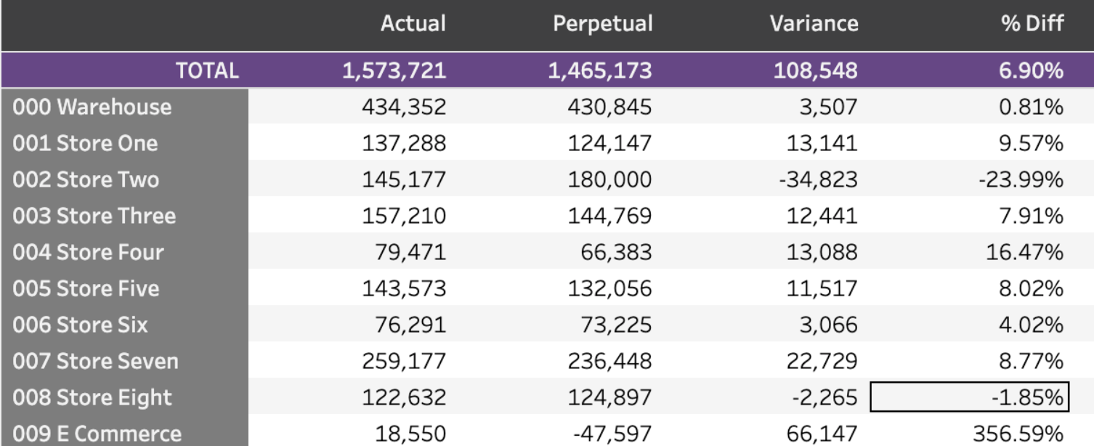
Understanding the numbers
This section looks at the differences each month- these tell you how the POS is differing from the calculated values of inventory
If largely different, you will want to discuss with client.
6

Slide 7
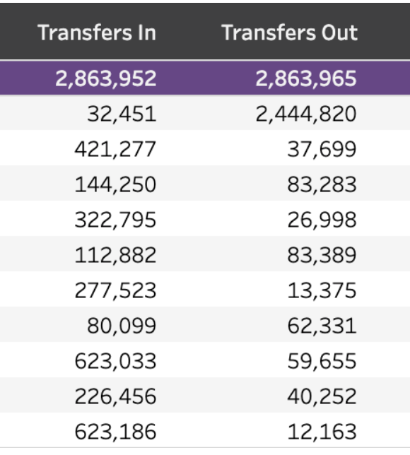
Understanding the numbers
Make sure the “Transfers In” match the “Transfers Out”.
This section is a great way to see what classes are being transferred to what stores.
This may help determine projected inventory adjustments or even discussions on what exactly sells better in which locations and how to plan assortment mixes better.
7

Slide 8
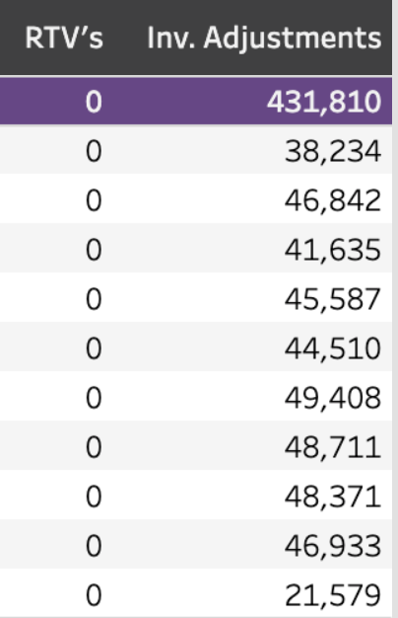
Understanding the numbers
RTVs- return to vendor by retail
Inventory Adjustments look at any changes in inventory not pertaining to one of the other sections or a transaction. Keep in mind this is any sort of movement that isn’t tied to a sales transaction. Could be donations, owner or employee clothing allowance, damaged goods, etc)
8

Slide 9
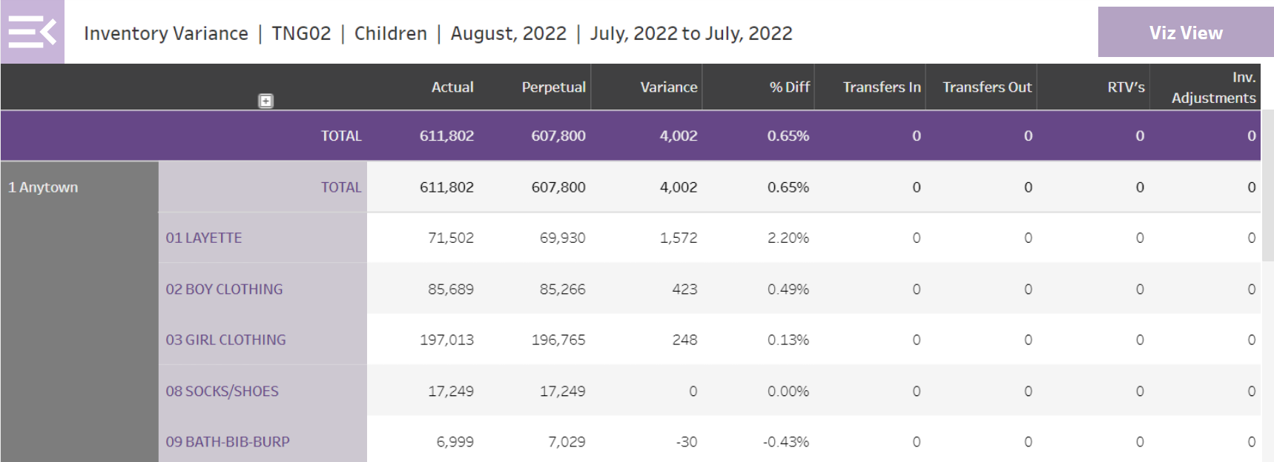
Inventory Variance
If this number was 50,000, we have bad data or a serious issue
It is a good practice to always review the Inventory Variance Report before you work plans.
This is where you will see if something is wrong with the data due to shuttle problems, receiving errors, etc.
This allows the problem to be fixed and new plans generated prior to meeting with the retailer.

