Slide 1



Progress report

Slide 2


Progress Report
Purpose of this report
Mid-month analysis of progress to the plan drives action that can help clients meet the plan.
Looks at month to date actuals vs forecast vs last year.
Also looks at totals: forecast vs trend vs last year.
Used monthly throughout the month
2

Slide 3
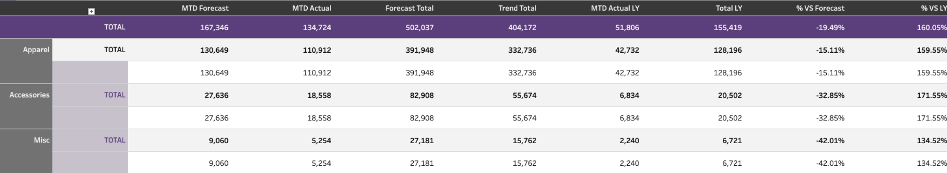
Progress Report
(shown by category)
3

Slide 4
The header
Looks at the forecasted sales month to date vs the actual sales month to date
Looks at the total forecasted month sales vs the total month sales trend
Looks at the month to date sales from last year as well as total month sales from last year
Looks at the actual sales month to date vs forecasted sales month to date
Looks at the actual sales month to date vs last year sales month to date
4

Slide 5
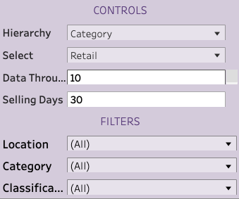
Organizing the data
Similar to many of the other reports, you have the capability to choose how you want to view the data.
You can control the way it’s organized (hierarchy) as well as retail vs cost.
You can modify the selling days based on days the store is open during a given period.
You can filter by specific locations, categories or classifications to isolate trends for individual buyers.
5

Slide 6
How to use the report
How is the client actually performing to plan, month to date?
This information can be used multiple times throughout the month to help fuel marketing decisions, sales associate incentives reorders, or even promotions.
Is there a specific store, category or class that isn’t on trend based off of month to date actuals?
What can we do if it’s underperforming?
How can you keep it going to maximize revenue if a given grouping or location is overperforming?
6

Slide 7
How to use the report
See month to date actuals in comparison to same month last year.
The relevance of this comparison varies. 2020 data, for instance, does not make for good comparisons due to store closures.
The % difference values make comparisons easy.
7

Slide 8
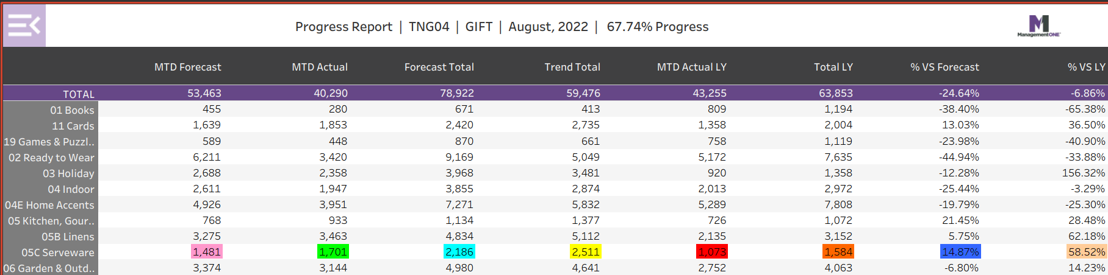
Progress Report: Daily Report Card for Retailers
The Progress Report is a great report for a retailer to view daily to see how the business, location and classes are performing relative to Plan.
This sample highlights the MTD performance for Serveware. The MTD forecast based on Plan is 1,481, the actual as of 67.74% of the month completed is 1,701, the Forecast or Plan for the entire month is 2,186, the Trend for the entire month’s sales is 2,511 based on MTD sales, the actual sales on this month one year ago were 1,073, total sales for this month one year ago were 1,584, this Sales this month is 14.87% above the Forecast and 58.52% higher than last year.

